Slide 1
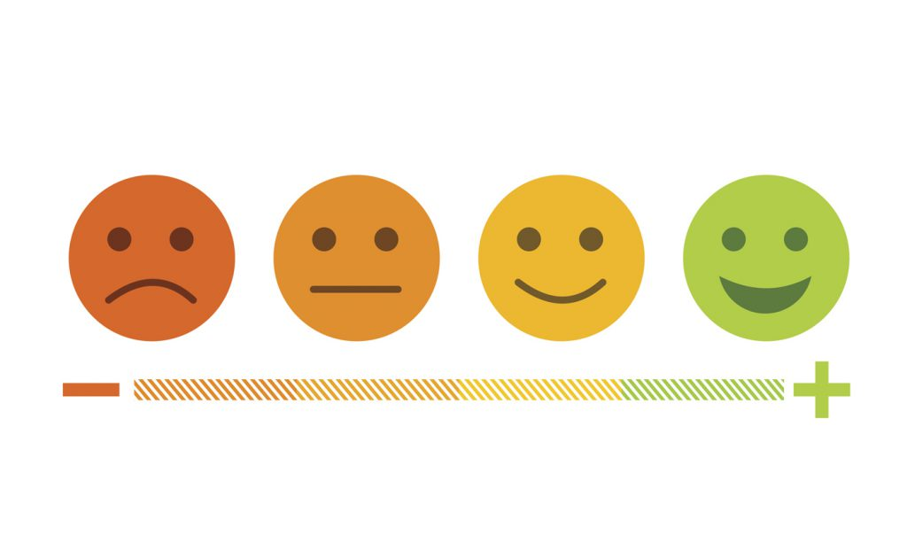


MEDICAL ALERT SYSTEM USING EMOTION DETECTION
GROUP - 8

Slide 2

Index
ABOUT THE TEAM
PROJECT OUTLINE
ABSTRACT
BUSINESS USE CASE
CONCEPTS USED
OUR DATA
DATA PROCESSING
ALGORITHMS USED
COMPARISON OF MODELS
LIMITATIONS

Slide 3
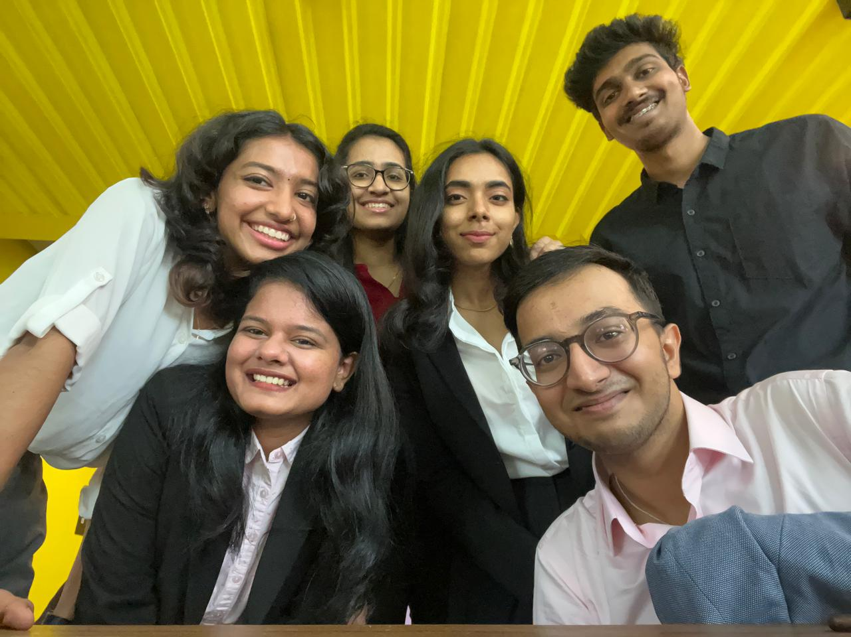
We the Team!
Riya Eliza Shaju
Abhinav Bandaru
Jakkampudi Renu
Tanisha Pal
Rucha Anand Jevalikar
Hussain Sakarwala

Slide 4
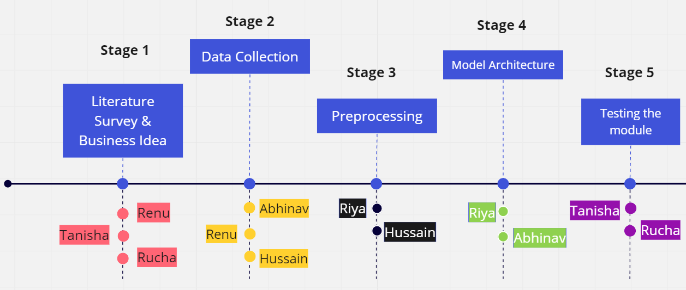
Project Outline

Slide 5
Literature Survey
Dataset - FER2013, Custom dataset from medical centers, CMU-MOSI and CMU-MOSEI
Preprocessing - Resizing the image, Converting to grayscale
Architecture - CNN, CNN+LSTM, Neuro Fuzzy logic, Optimization algorithms
Metrics - Precision, F1 Score, Recall
Accuracy - Precision: 77.8 to 99.5 by using a DFFN model
Application - Face recognition, security for data collected, lie detection, use cases in various scenarios.
Link : Literature Survey

Slide 6





Holistic Objectives
Emotion Recognition in Healthcare
Medical Alert System
Real-time Detection
Improved assistance

Slide 7
Abstract
WHO notes that, with 1.7 nurses per 1,000 people, India falls short of their recommended rate of 3 nurses per 1,000 people and that, in order to comply with WHO standards by 2024, the nation will require 4.3 million more nurses. To tackle this, we suggest a novel system; being an AI-based emergency monitoring system that would enable real-time surveillance and instantly detect changes in comfort by detecting real-time facial expressions, to warn medical personnel and emergency contacts. This would optimize the problem of rigorous training of nurses and aid them to give adequate attention to patients.
As a result, our system will accurately identify faces, evaluate sentiment, and alert the healthcare division to view the patient's situation.

Slide 8


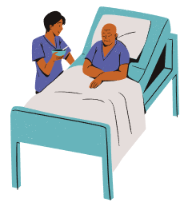

Business Use Case
An addition to basic amenities.
Automating 24-hour monitoring service.
Software capable of detecting distressing emotions.
Commercially viable
An aid rather than a replacement.

Slide 9
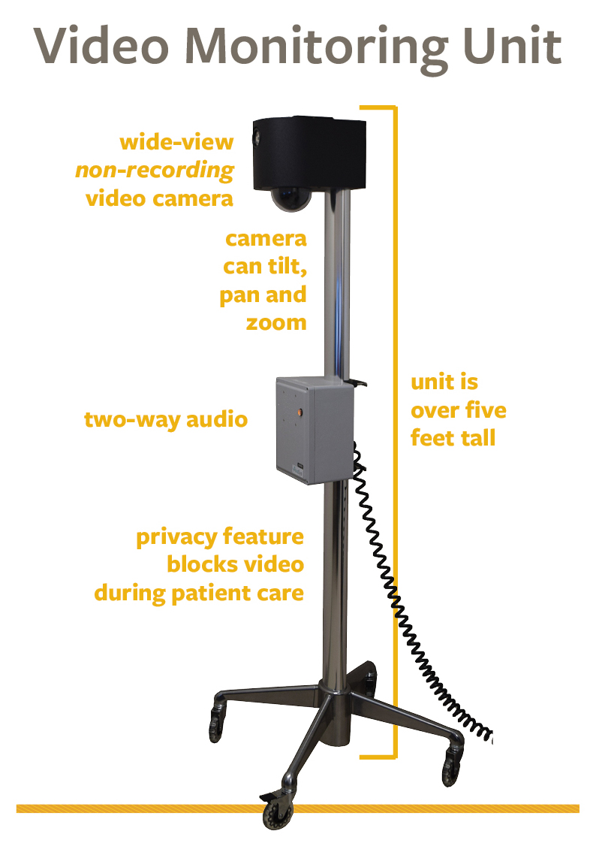
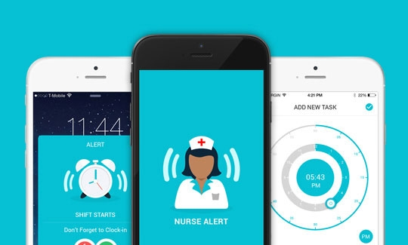
Business Use Case

Slide 10
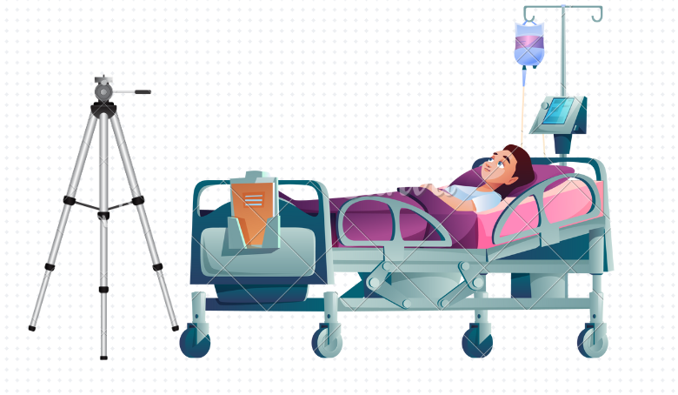

Business Use Case

Slide 11
Business Use Case
Subscription Service : AI-monitored care could act like a service that patients can choose to avail. It will act as an ‘extra eye’ to keep the patient in check.
Psychiatric Patient treatment: Can be used as a monitoring system especially for mentally-ill patients in rehab centres.
Pandemic : At a time when medical professionals were overwhelmed, our model could have reduced the reaction time of nurses, while avoiding human contact.

Slide 12
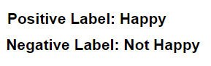
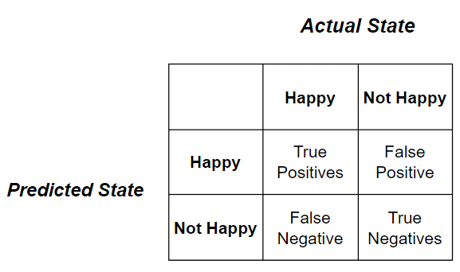
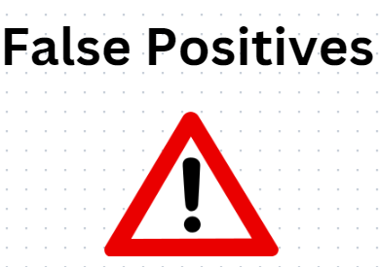
Concepts used

Slide 13
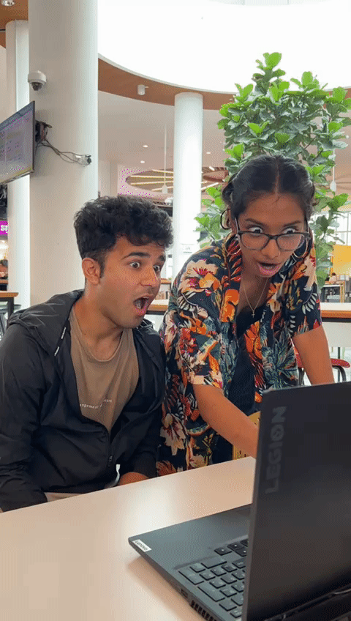









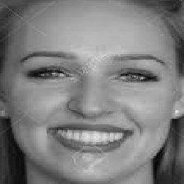
Our Data
240 x 240, 28k jpg images
Custom data - Pygame
48 x 48, 36k jpg images, FER2013
240 x 240, 750 png images, CK+

Slide 14
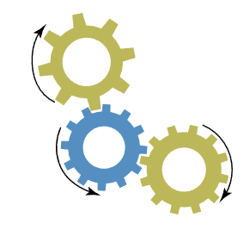
Pre-processing
Data collection and processing were done as follows:
The data was self collected using the PyGame library and by slicing live-feed from a local desktop camera.
Frames were collected as images according to the set limit.
By keystrokes, the data collector and subject were able to navigate through pygame.camera() module and capture required data.
The subject was asked to mimic the required emotion and these emotions were recorded and saved to the local drive in realtime.
Approximately 50,000 images were collected, which, after cleaning, have resulted in ~28,000 images.

Slide 15

Algorithm Used
For this project we used the following models:
Transfer learning using MobileNet
CNN
Convolutional bidirectional LSTM

Slide 16
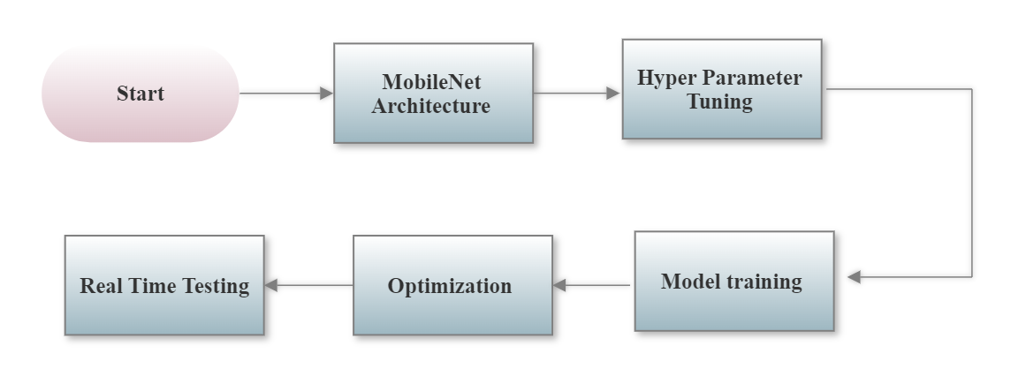
Transfer Learning

Slide 17
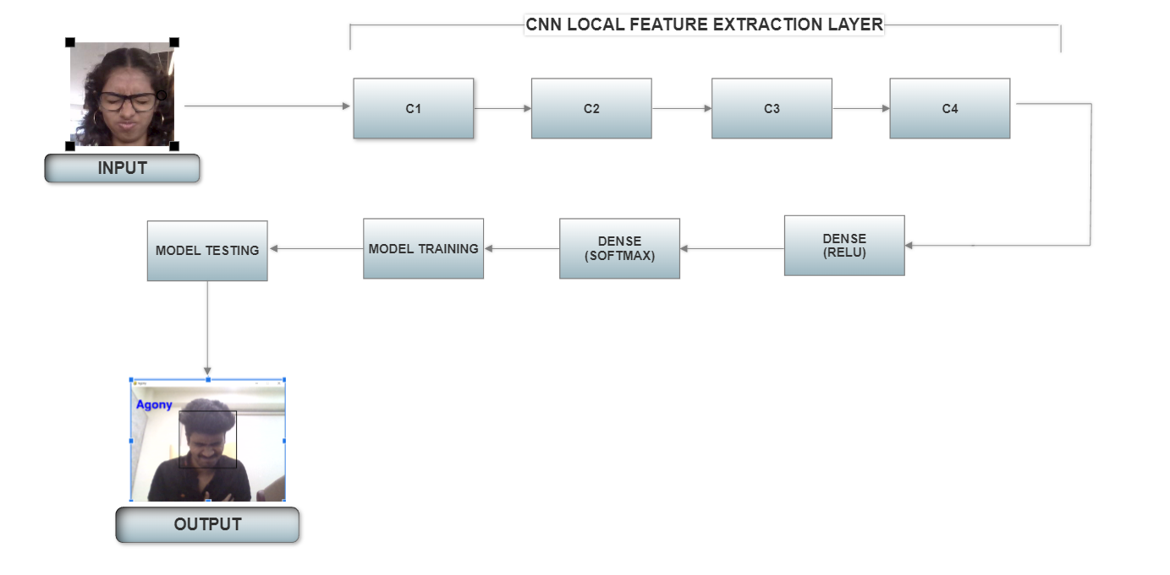
CNN

Slide 18
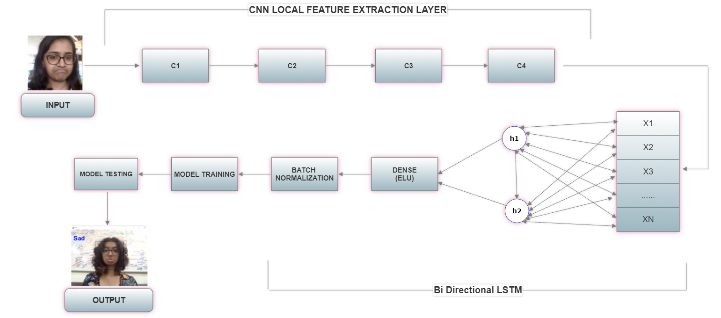
CNN + BIDIRECTIONAL LSTM

Slide 19
Comparison of Models
Model | Layers | Accuracy
CNN | 6 | 92.22
CNN+Bi-directional LSTM | 6 | 81.56
MobileNet | 18 | 99.94

Slide 20
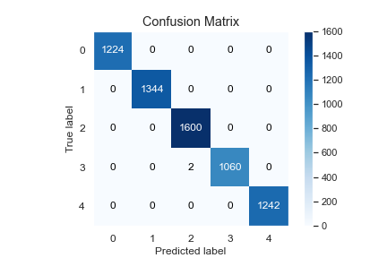
Confusion matrix

Slide 21
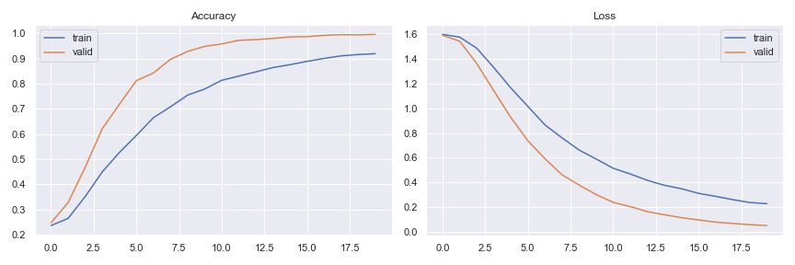
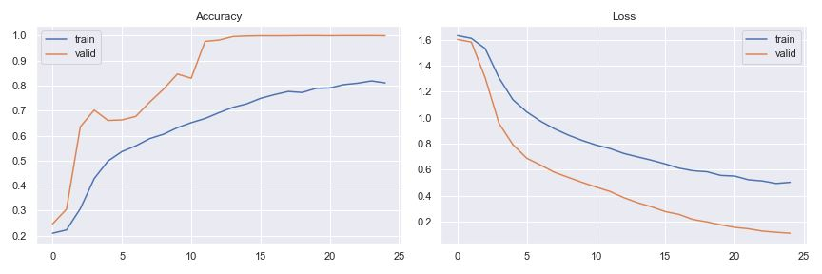
CNN
CNN+Bi- Directional LSTM
Accuracy Function
Loss Function

Slide 22
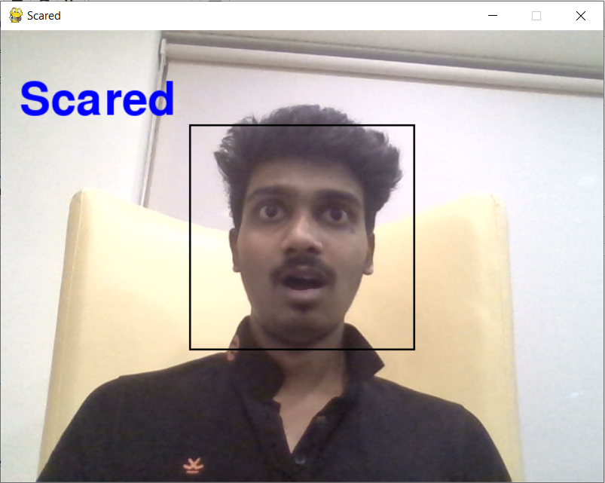
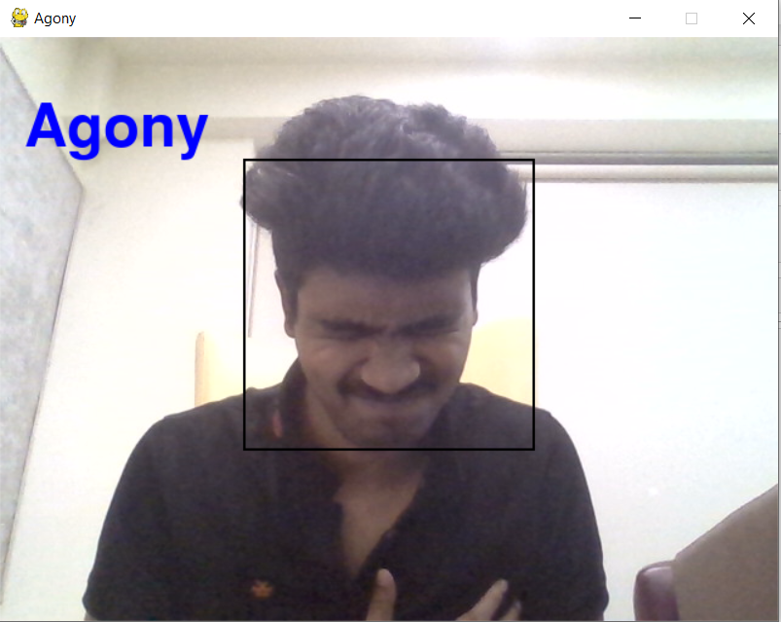
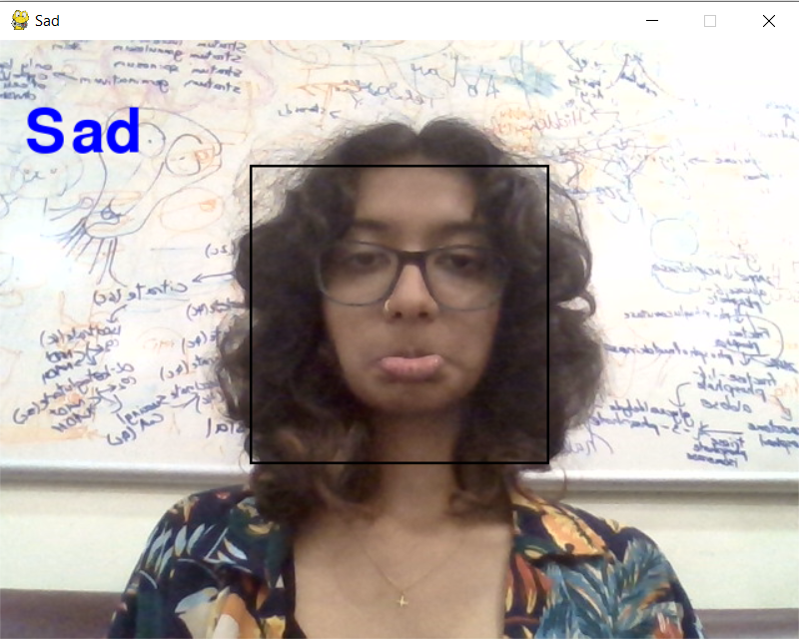
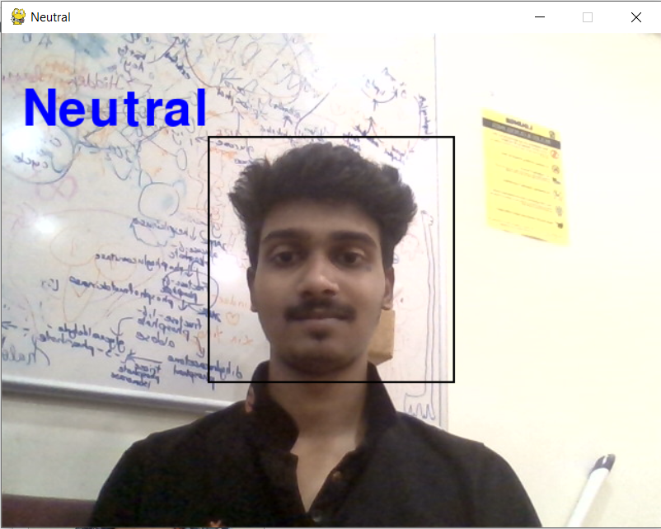
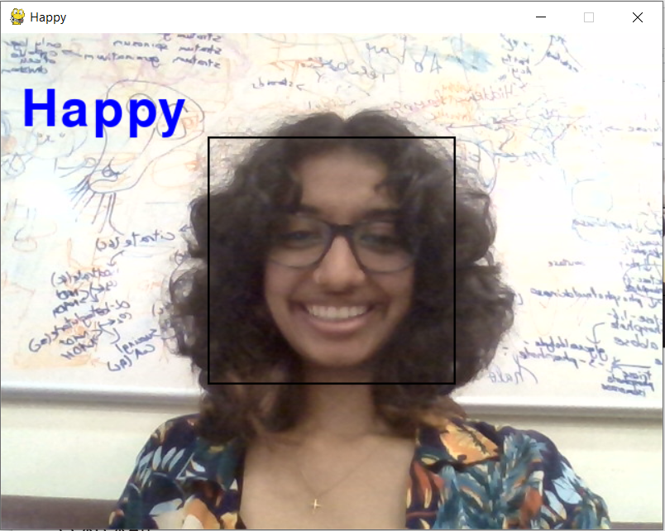
Visualization

Slide 23

Optimal Case
The optimal case in our scenario would be if the patient is facing the camera and there is an appreciable amount of light around the patient. We also wish to implement an alert system so ideally we wish to reduce the number of false positives and spam alerts.
Additionally our model should be as light as possible without compromising the accuracy.

Slide 24
Final Recommendation
Emotion detection is a problem that is largely dependent on the dataset. Since we work with a big set of images, we need to find the optimal trade-off between complexity and error rate. Based on the data we gathered by experimenting with various architectures (CNNs, Bi-Directional LSTMs, Mobilenet), we have found Mobilenet architecture to be an appreciable estimation of our final goal.
With a little more data, little more time and effort, it is possible to create a emotion detection system that can uphold the industry standards required in a healthcare facility.

Slide 25

Challenges Faced
Overfitting
An Alternative to OpenCV
Trial and Error of Testing and Training different Models
Diverse Educational Backgrounds

Slide 26
Our Learning
Technical
Equivalent functions
Data collection automation
Personal
Volunteering
Accepting responsibility
Research
Medical negligence
Unexplored applications
Business
Identifying a gap in the market
Identifying the product/service that best fills this gap
Analyzing cost-cutting mechanisms
Social
Combining diverse skill sets
Teamwork, Leadership, Communication

Slide 27
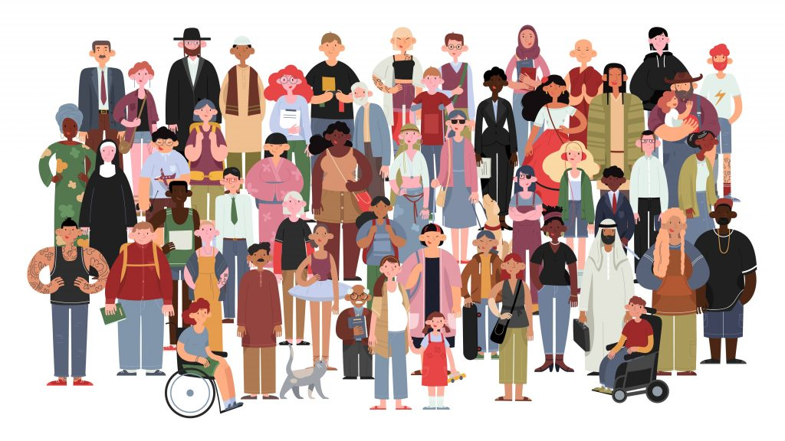
Future Enhancements
Data diversity - Race & Age
Model accuracy of patients with wearables (masks, spectacles)
Multiple Face Emotion Recognition
Night Vision
Face Detection before Face recognition

Slide 28
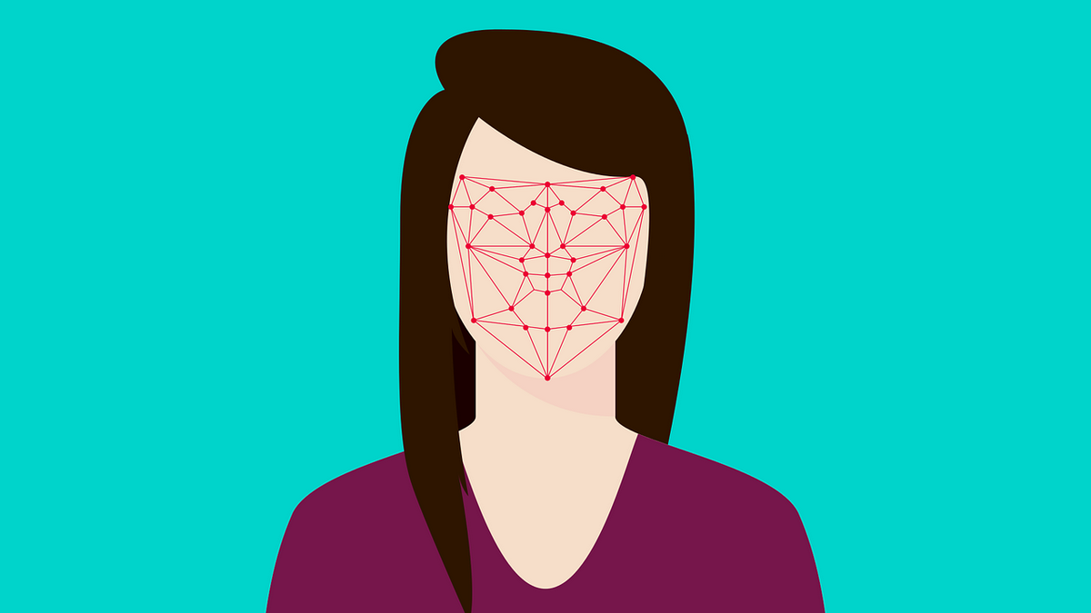
Demo
Live feed demo

Slide 29
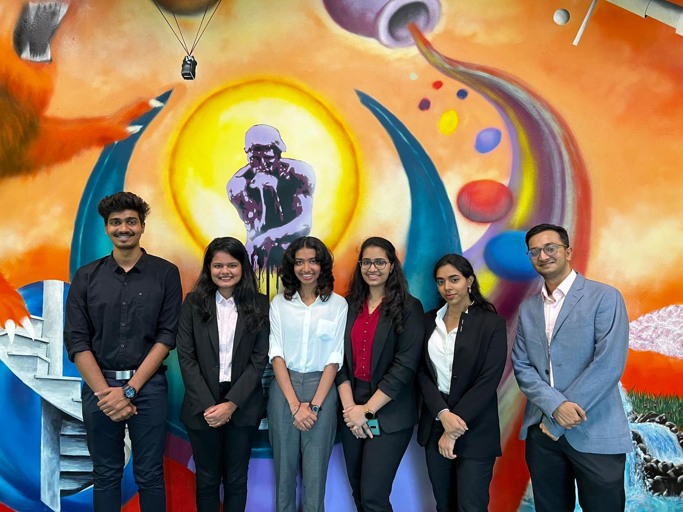
GROUP-8
Thank You

